Slide 1

PHYSICS-INFORMED RADIAL BASIS FUNCTION NETWORKS AND KOLMOGOROV-ARNOLD NETWORKS
Аспирант Д.А. Стенькин
(научный руководитель д.т.н., профессор В.И. Горбаченко)

Slide 2
PURPOSE, OBJECTIVES, RESEARCH METHODOLOGY
The aim of the work is to develop algorithms and programs for solving direct and inverse boundary value problems of mathematical physics that describe processes in homogeneous and piecewise homogeneous media on physically informed networks of radial basis functions using the gradient descent method, the Levenberg-Marquardt method, the Hessian diagonal approximation method, and to develop algorithms and programs for solving the Navier-Stokes differential equation system on physically informed networks of radial basis functions using the Nesterov method.
Tasks of the work:
Analysis of radial basis functions. Analysis of networks of radial basis functions when solving direct and inverse boundary value problems that model processes in homogeneous and piecewise homogeneous media.
Development of algorithms for solving various direct boundary value problems using networks of radial basis functions.
Development of an algorithm for solving direct boundary value problems describing piecewise homogeneous media using networks of radial basis functions.
Development of an algorithm for solving inverse boundary value problems for a piecewise homogeneous medium using networks of radial basis functions.
Development and study of software packages implementing algorithms for solving a direct boundary value problem.
Development and study of a software package implementing an algorithm for solving a direct boundary value problem that models processes in a piecewise homogeneous medium. Conducting an analysis of experiments for this model problem.
Development and study of a software package implementing an algorithm for solving an inverse boundary value problem that models processes in a piecewise homogeneous medium. Conducting an analysis of experiments for this model problem.
Development of an algorithm for solving a system of Navier-Stokes differential equations using networks of radial basis functions.
Development and study of a software package implementing an algorithm for solving a system of Navier-Stokes differential equations. Conducting an analysis of experiments for this model problem.
Research methodology:
Optimization methods are the mathematical basis for developing algorithms for training a network that solves direct and inverse boundary value problems.

Slide 3
KOLMOGOROV-ARNOLD NETWORKS
Kolmogorov-Arnold networks are based on the Kolmogorov-Arnold theorem, which states that any continuous multivariate function , defined on a bounded domain can be represented as a finite composition of continuous one-dimensional functions and addition operations. Mathematically, this is expressed as:
Radial basis function networks are similar to Kolmogorov-Arnold networks in that in both types of networks the inputs of the first layer are nonlinearly transformed using basis functions and added together.

Slide 4
SOLVING A BOUNDARY VALUE PROBLEM ON PHYSICS-INFORMED NEURAL NETWORKS
The boundary value problem to be solved
where — differential operator, — function, — the desired solution, — vector of space-time coordinates, — task parameter, — boundary condition operator, — additional conditions operator, — boundary function, — —additional conditions function, — solution area, — solution domain boundary.
Vector of network parameters
Loss function
where — number of trial points for the equation, boundary conditions and additional conditions,
— user-defined or configurable weighting coefficients during network training.

Slide 5
RADIAL BASIS FUNCTION NETWORKS
Gaussian function

Slide 6
TRAINING RADIAL BASIS FUNCTION NETWORKS
Gradient Descent Algorithm
where — parameter vector correction, — hyperparameter being selected (learning rate),
— gradient vector of the loss function over the components of the vector on iteration .
Levenberg-Marquardt algorithm
where — Jacobian matrix calculated from the values ​​of the network parameters iterations, — identity matrix, — regularization parameter, — gradient of the loss function with respect to the parameter vector ,
— vector of residuals at trial points in the solution domain and on the boundary of the solution domain.
Nesterov's algorithm
where — vector of one of the network parameters (one can consider the vector of all parameters),
— the selected numerical coefficient (learning rate), — moment coefficient,
taking values ​​in the interval[−0.5; 1.5].

Slide 7
TRAINING RADIAL BASIS FUNCTION NETWORKS
Due to the convenient structure of neural networks, all formulas for the first and second derivatives were obtained analytically. For the Hessian diagonal approximation method when solving the Poisson equation, the values ​​of the elements located on the main diagonal can be obtained based on the following formula
$$η$$
The vector of weight coefficients in the Hessian diagonal approximation method is calculated using the formula
where and – learning rate coefficients.

Slide 8
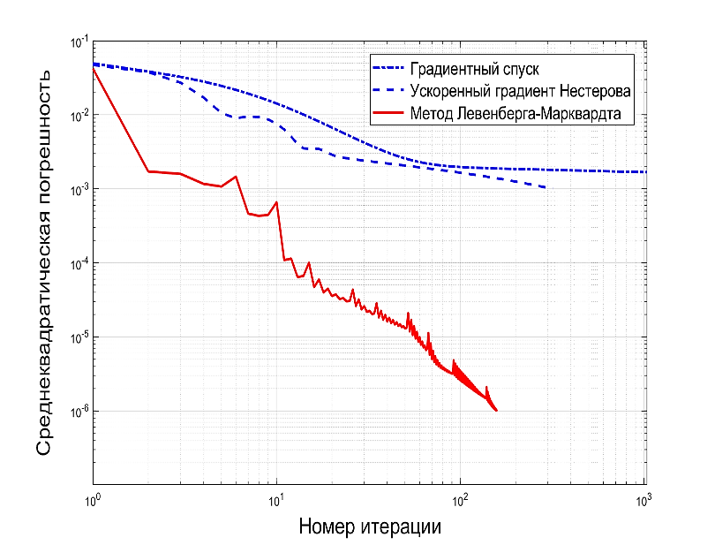
EXAMPLE OF SOLVING A MODEL PROBLEM
Model problem
The number of test points inside and on the boundary of the solution area is and , respectively. The problem was solved on a computer with an Intel Core i5 8500 processor, a frequency of 3.0 GHz and 16.0 GB of RAM.
Dependences of the mean square residual of various algorithms on the iteration number
RBF in solving a boundary value problem
Algorithm | Achieved mean square error | Number of iterations | Time of decision, С
Gradient Descent Algorithm | 3*10⁻³ | 1000 | 1100
Algorithm of Nesterov's method | 7*10⁻⁴ | 1000 | 1120
Levenberg-Marquardt Method Algorithm | 10⁻⁶ | 30 | 8,5

Slide 9
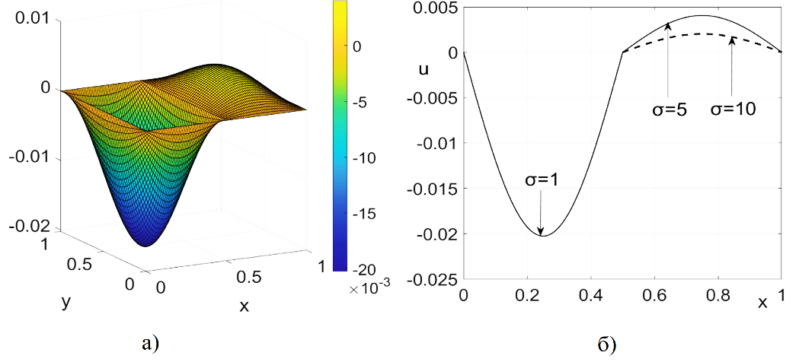
SOLUTION OF DIRECT PROBLEMS FOR PIECEWISE HOMOGENEOUS MEDIA
Problem to be solved
Loss function
Solution graphs: a) approximate solution; b) solution graph in the middle section

Slide 10
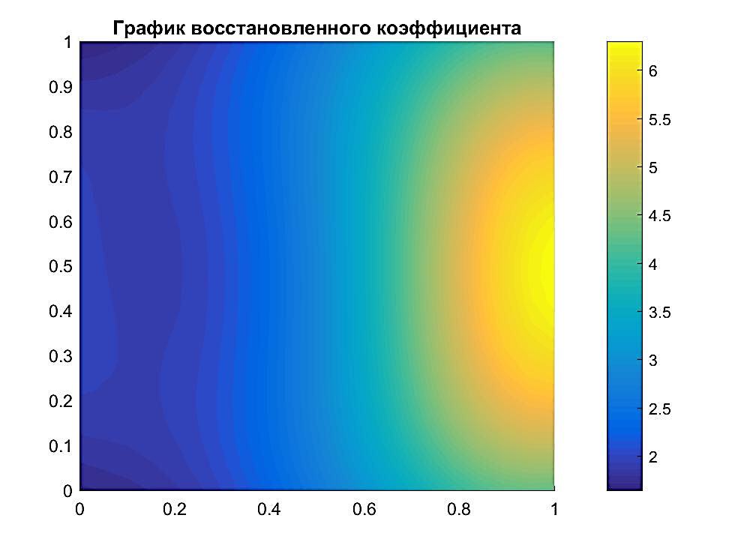
SOLUTION OF INVERSE PROBLEMS FOR PIECEWISE HOMOGENEOUS MEDIA
It is necessary to find the solution and the function from the solution known at some set of points
We use parametric optimization. For this, we approximate the unknown function with a network of radial basis functions
The solution to the direct problem is found by the second network of radial basis functions
Loss function
Solution of the direct problem: a) solution of the original direct problem; b) reconstructed solution of the direct problem
Calculated values ​​of the environment function

Slide 11
ALGORITHM FOR SOLVING NAVIER-STOKES EQUATIONS
Let's consider the model flow of Kovazhny. The Kovazhny flow is a two-dimensional stationary flow.
The analytical solution has the form
The two-dimensional stationary Navier–Stokes equations for an incompressible medium have the form
Loss function

Slide 12
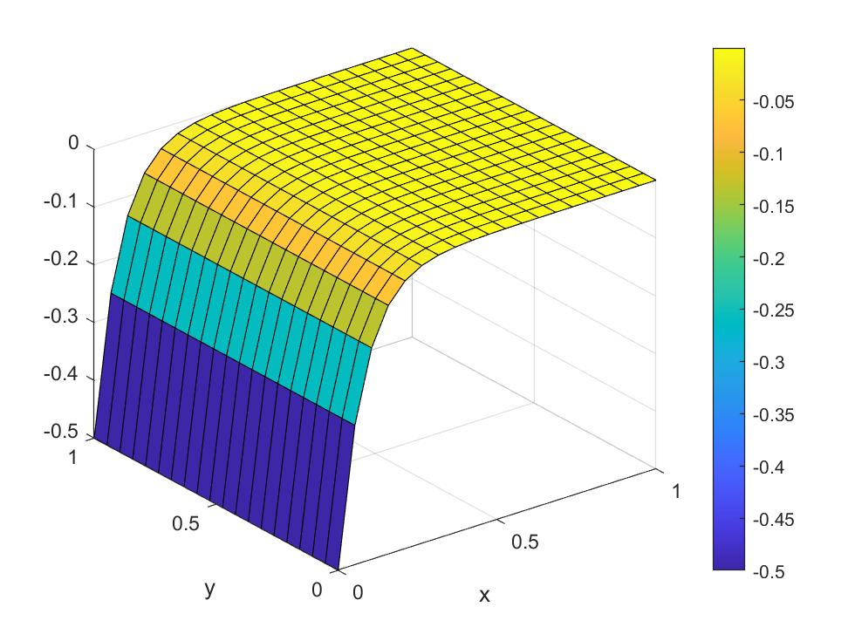
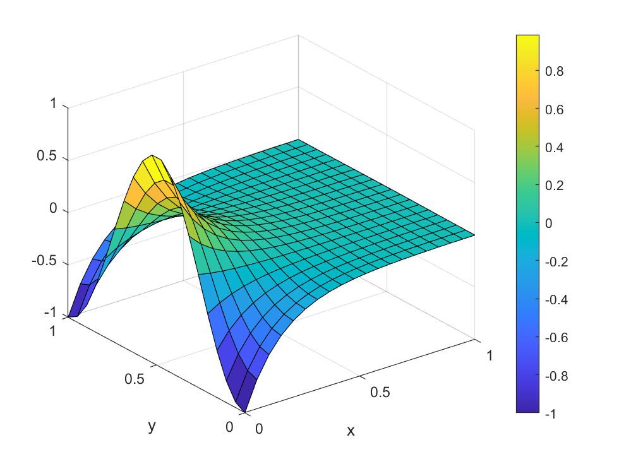
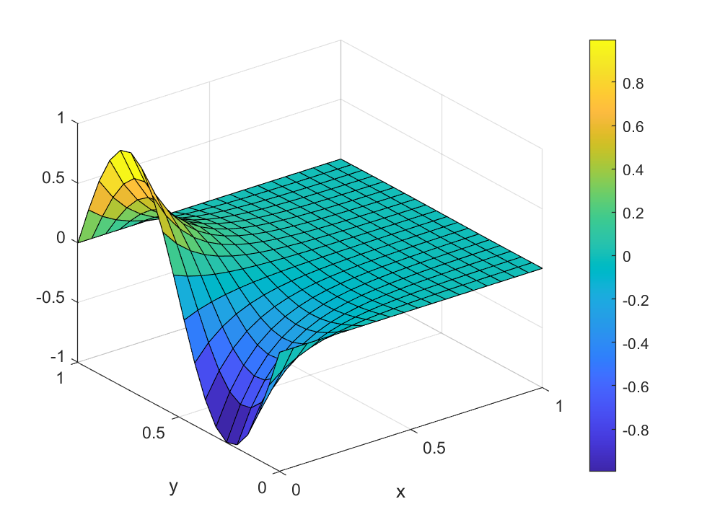
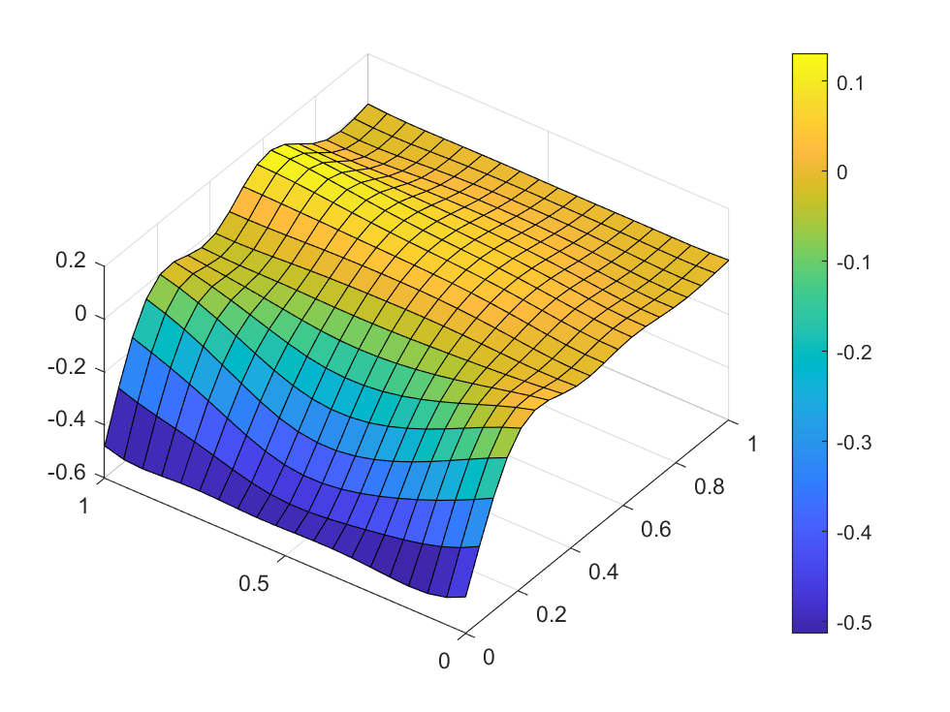
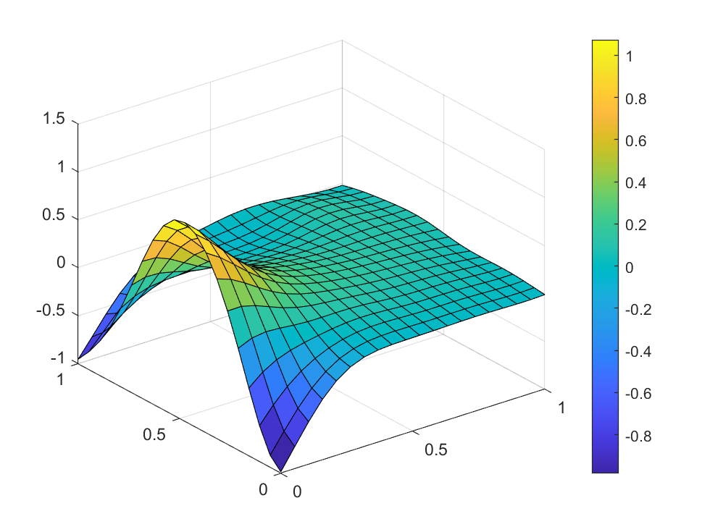
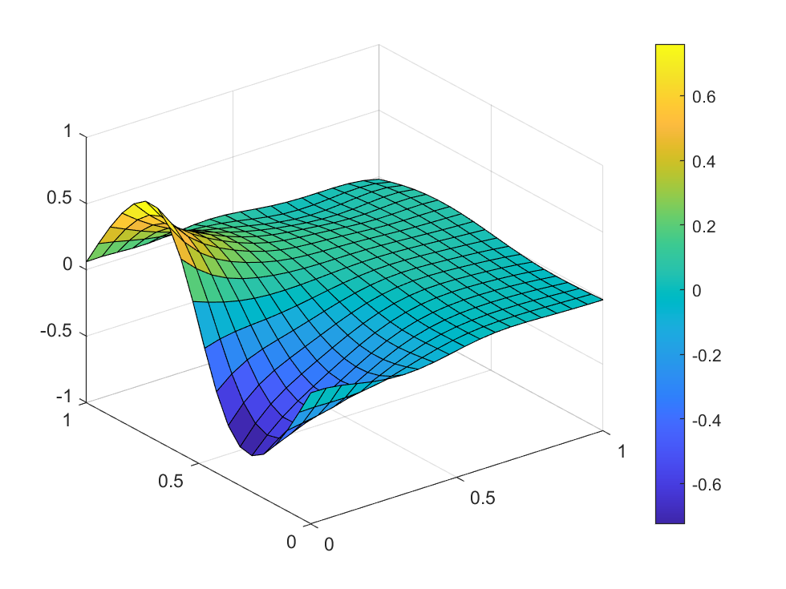
RESULTS OF SOLVING THE NAVIER-STOKES EQUATIONS
Analytical solution for
pressure.
Analytical solution for the first component of velocity.
Analytical solution for the second component of velocity.
Pressure obtained as a result of the network operation.
The first component of speed obtained as a result of network operation.
The second component of speed obtained as a result of network operation.

Slide 13
RESULTS AND CONCLUSIONS
New meshless algorithms for solving boundary value problems that model processes in a piecewise homogeneous medium have been developed. The algorithms have been implemented using physically informed networks of radial basis functions trained using the Levenberg-Marquardt method. The algorithm for solving the direct problem is based on solving individual problems for each region with different properties of the medium. This removes restrictions on the radial basis functions used. The algorithm for solving the inverse problem has been implemented using parametric optimization. The algorithms are based on the fast Levenberg-Marquardt method. Working formulas for calculating the elements of the Jacobian matrix have been obtained. Solution programs have been developed using model problems as an example. An algorithm based on the Hessian diagonal approximation method has been developed to train physically informed networks of radial basis functions. A meshless algorithm for solving a system of Navier-Stokes differential equations on physically informed networks of radial basis functions has been developed, implemented, and experimentally studied. Using a model problem as an example, programs for solving two-dimensional stationary Navier-Stokes equations using physically informed radial basis function networks trained using the Nesterov method were developed.
Radial basis function networks are a promising class of physics-based neural networks and can be effectively used to solve direct and inverse boundary value problems described by partial differential equations.
Further research areas include improving the training algorithms for radial basis function networks, developing extensions of deep learning libraries for implementing radial basis function networks and automatic differentiation for such networks, as well as solving more complex model and real problems.

Slide 14
THANK YOU FOR YOUR ATTENTION!

